Slide 1
miRNA Expression Analysis
Paper Review + Project Update
Dvir Netanely
Ron Shamir’s Group Meeting 28.11.2012
TAU

Slide 2

Inferring the perturbed microRNA regulatory networks in cancer using hierarchical gene co-expression signatures
Paper Review
Jin Gu^{1,*}, Zhenyu Xuan²

Slide 3
Background

Slide 4
micro RNA (miRNA)
MicroRNAs (miRNAs) are a class of endogenous small (~22nt) regulatory RNAs that play important roles in many biological and physiological processes.
About 1,400 miRNAs have been identified in human and more than 30% known protein-coding genes are potentially regulated by evolutionary conserved miRNAs.

Slide 5
miRNA Biogenesis
MicroRNA genes reside in regions of the genome as distinct transcriptional units as well as in clusters of polycistronic units - carrying the information of several microRNAs
RNA polymerase II transcribes miRNA genes, generating long primary transcripts (pri-miRNAs)
In the nucleus, the RNase III–type enzyme Drosha processes the long primary transcripts, yielding a 70 nt long hairpin precursors (pre-miRNA).
The pre-miRNA hairpins are exported to the cytoplasm where they are further processed into unstable, 19-25 nt miRNA duplex structures by the RNase III protein Dicer
The less stable of the two strands in the duplex is incorporated into a multiple-protein nuclease complex, the RNA-induced silencing complex (RISC), which regulates protein expression.
Once incorporated into a RISC, the miRNA is situated to regulate the target genes by degradation of the mRNA through direct cleavage or by inhibiting protein synthesis.

Slide 6
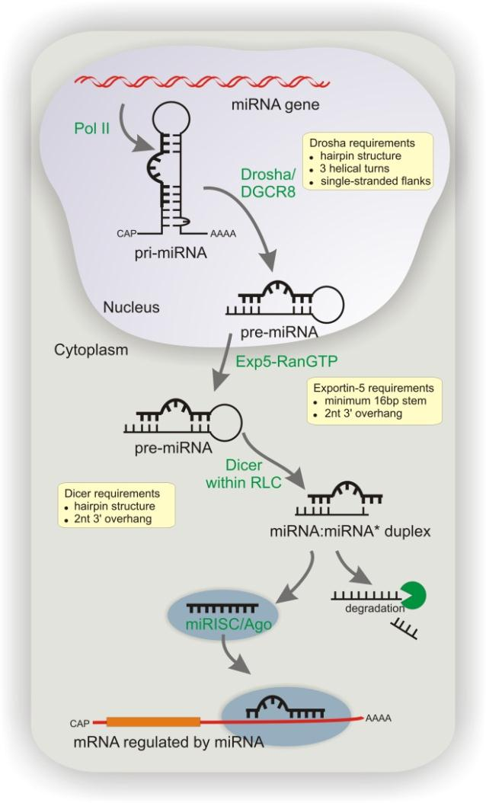

Slide 7
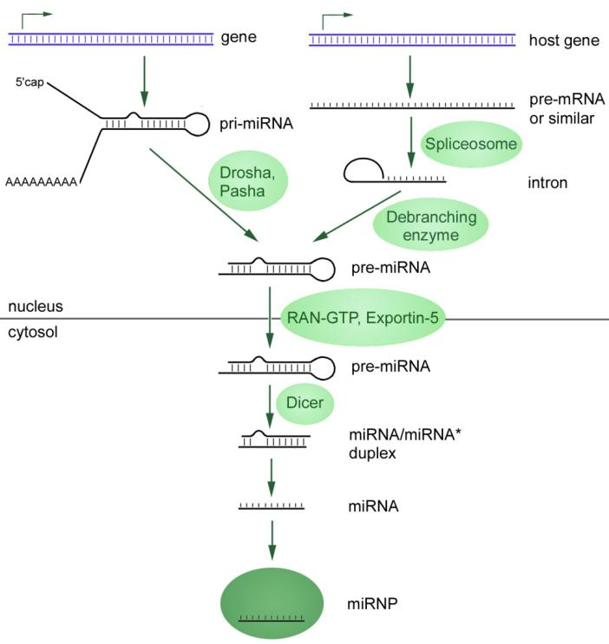

Slide 8
miRNA Target Prediction
In animals, the tendency of miRNAs to bind their mRNA targets with imperfect sequence homology poses considerable challenges with target prediction.
Several computational approaches have been developed to predict miRNA targets.
In general, computational target prediction identifies potential binding sites according to base-pairing rules and cross species conservation conditions.

Slide 9
TargetScan
Predicts biological targets of miRNAs by searching for the presence of conserved 8mer and 7mer sites that match the seed region of each miRNA .
In mammals, predictions are ranked based on the predicted efficacy of targeting as calculated using the context+ scores of the sites.
As an option, predictions are also ranked by their probability of conserved targeting (P_{CT}).

Slide 10
TargetScan’s context score
The context+ score for a specific site is the sum of the contribution of these six features, calculated as in Garcia et al., 2011:
  site-type contribution (6mer, 8mer…)
  3' pairing contribution
  local AU contribution
  position contribution
  TA (target site abundance) contribution (New in TS6)
  SPS (seed-pairing stability) contribution (New in TS6)
For each predicted target of each miRNA, the sum of the context+ scores for the sites was calculated as the total context+ score.

Slide 11
Introduction

Slide 12
miRNA and Cancer
miRNAs have a role in cancer and may distinguish types.
Although hundreds of miRNAs have been discovered, the perturbed miRNA regulatory networks and their functions are still poorly understood in cancer.
Due to the complexity of cancer transcriptome, current methods often encounter low sensitivity and report few onco-miR candidates.

Slide 13
miRHiC enrichment analysis of miRNA targets in Hierarchical gene Co-expression signatures
The miRHiC method infers the perturbed miRNA regulatory networks by using the hierarchical co-expression signatures of the differentially expressed genes.
Demonstrated on three cancer datasets.

Slide 14
Materials and Methods

Slide 15
Dataset Analysis - I
Acquisition, pre-processing and identification of differentially expressed genes
Downloaded 3 cancer gene expression datasets from GEO:
  Lung cancer (LUC)
    60 paired cancer and para-cancer* samples
  Hepatocellular cancer (HCC)
    96 paired cancer and para-cancer samples
  Colorectal cancer (CRC)
    35 cancer and 24 normal samples
Removed lowly expressed genes
  (kept only genes in which at least 30% of the values ranked as the 10K values *)
Applied t-test and kept top 2000 significant differentially expressed genes on each dataset
  (length of FDR list varied greatly between datasets making comparison problematic *)

Slide 16
Dataset Analysis - II
TargetScan
Downloaded TargetScan’s data mapping miRNA families with their predicted mRNA targets.
For each miRNA-mRNA pair, its summarized context score was recorded (a negative score measuring miRNA-target regulation strength or confidence, provided by TargetScan).

Slide 17
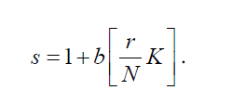
Dataset Analysis - III
Calculating K-discretized context score
miRNA-mRNA pairs were sorted descendingly based on their context scores
  pairs ranked on the top have the lowest regulation strength
A discretized context score (into K levels) was calculated such that a pair ranked r^{th} will have the score:
It means the first 1/K miRNA-target pairs have lowest score 1, while the last 1/K pairs have highest score 1+b(K-1).
According to FAME, K is set as 5 and b as 3 in this study*.

Slide 18
Dataset Analysis - III
Calculating K-discretized context score
Control:
  The control miRNA target gene sets were generated by bipartite graph based random permutation of the miRNA-target pairs with the same discretized scores but keeping the sizes of all target gene sets.

Slide 19
miRHiC’s steps:
Clustering the differentially expressed genes based on pairwise co-expression correlation between genes
miRNA target gene set enrichment is analyzed across the hierarchical co-expression signatures
finally, a permutation test is used to estimate the statistical significance of the enrichment

Slide 20
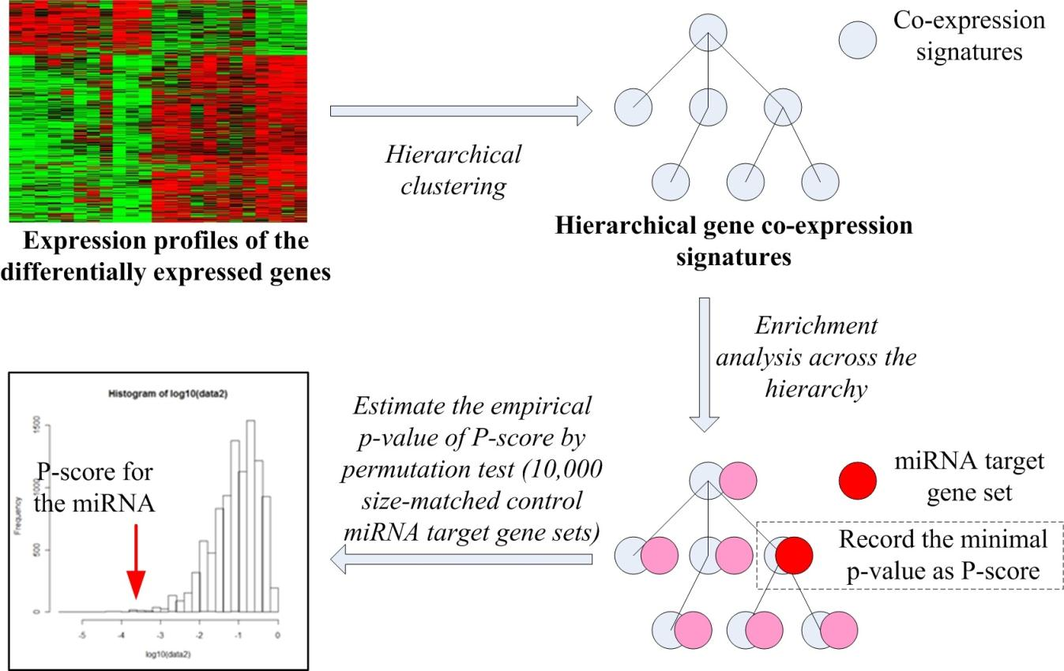
miRHiC

Slide 21
Hierarchical gene co-expression signatures
Top 2000 differentially expressed genes were clustered using hierarchical clustering.
Spearman’s rank correlation was used as a distance matrix.
Hierarchy was cut at certain correlation cutoff to reduce noise (z-score==0.52, pValue=0.3).
Extraction of gene co-expression signatures (clusters) at different scales by traversing the co-expression hierarchy from leaf to root according to certain rules.
  (the correlation is decreasing and the size of signatures is increasing when traversing the hierarchy from leaf to root)

Slide 22
Hierarchical gene co-expression signatures
Rules for extracting gene co-expression signatures:
A new cluster is initiated, if the cluster contains the minimum number of genes N^{i}
  (N^{i} is set as 5% of the number of differentially expressed genes, 100 in this study)
A cluster is extended, if it merges a branch with less than N^{e} genes
  (N^{e} is set as the maximum of 20 and 10% of the current cluster size)
A cluster is extended, if it merges another cluster which is very close (normalized cluster distance is less than 0.5) and the records of the two merged clusters are deleted
A cluster is extracted at current scale, if the cluster will merge a branch with more than N^{e} genes or it will merge a cluster with large distance. And a new cluster is initiated as the merged cluster

Slide 23
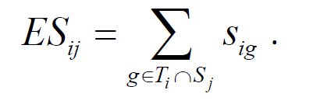
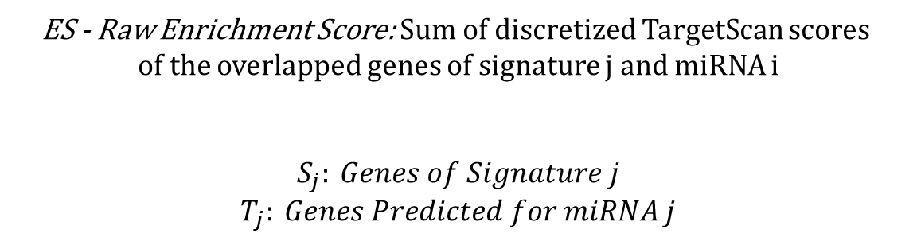
Calculating miRNA enrichment score
For each miRNA i, calculate enrichment in signature (cluster) j.
ES - Raw Enrichment Score: Sum of discretized TargetScan scores
of the overlapped genes of signature j and miRNA i
$$S_{j}: Genes of Signature j$$
$$T_{j}: Genes Predicted for miRNA j$$
Unlike HG, the enrichment is continuous
The discretization translates a negative fraction score into a positive discrete efficacy level
Very similar to what’s done in FAME

Slide 24
Calculating miRNA enrichment pValue
The p-value p_{ij} (for the enrichment of miRNA i on signature j) was estimated by examining the enrichment scores ES_{ij}(r) of 10,000 size-matched random control miRNA target gene sets:
P-score P_{i} for the i-th miRNA was calculated as the minimal p-value over all signatures (most significant enrichment):
The P-score was used to measure the miRNA target gene enrichment across the whole gene co-expression hierarchy.

Slide 25
Calculating miRNA enrichment pValue
The above P-score cannot be directly used to measure the statistical significance of enrichment because it is the minimal of a set of p-values, so it is not uniformly distributed along 0~1 (biased to 0).
Therefore a second permutation test was used to estimate the statistical significance of the P-score: P_{i} was calculated based on P-scores P_{i}(r) of 10,000 size-matched permuted control miRNA target gene sets (and later was also FDR corrected):

Slide 26
Comparisons with other methods
We have compared miRHiC with both Gene Set Enrichment Analysis (GSEA) and gene set analysis by hyper-geometric test (HG-test).
GSEA is a widely used method for inferring the perturbed gene sets by taking the continuous values and the rank information of differential gene expressions.
When comparing miRHiC with GSEA, the fold changes of gene expressions between cancer and normal samples were used in GSEA. (*Not Fair, FC is less informative than t-test)

Slide 27
Comparisons with other methods
GSEA and HG-test use different computational models to measure gene set enrichments with miRHiC.
For directly testing the advantage of using the hierarchical gene co-expression information, we used the 2,000 differentially expressed genes as the only cluster and ran miRHiC on it.
For clear presentation, we named this approach as miRDeG (enrichment analysis of miRNA targets in differentially expressed genes).
miRDeG can also be regarded as a special in-house implementation of FAME, by specifying the functional gene sets as the differentially expressed genes (without clustering and only summing context scores?)
?

Slide 28
Results

Slide 29
Inferring the perturbed miRNA regulatory networks in cancer
On the three cancer datasets, miRHiC inferred six, four and seven perturbed miRNAs or onco-miRs, respectively, with q-value < 0.1.
Under the same q-value cutoff, the three compared methods, GSEA, HG-test and miRDeG inferred much less .
Among all 17 inferences from miRHiC, nine are supported by more than five literatures in PubMed
These results indicate that miRHiC can greatly improve the sensitivity of detecting inferences with biological functions.
 | LUC | HCC | CRC
GSEA | 0 | 1 | 1
HG-test | 0 | 0 | 0
miRDeG | 1 | 0 | 0
miRHiC | 6 (4ª) | 4 (2) | 7 (3)
Table 1. The number of onco-miRs inferred by different methods with q-value < 0.1.
ª The number of inferred onco-miRs with more than five supported literatures in PubMed.

Slide 30
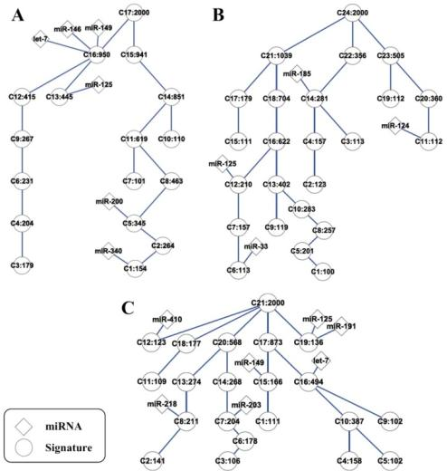
Inferring the perturbed miRNA regulatory networks in cancer
By looking at the targeted signatures of the inferred onco-miRs, we found that they have different levels of gene co-expressions in the hierarchies (Figure 3).
The GO functions associated with these signatures are significantly related to different hallmarks of cancer
Figure 3. The perturbed miRNA regulatory networks in multiple cancer inferred by miRHiC. A) is for lung cancer; B) for hepatocellular cancer; and C) for colorectal cancer.

Slide 31
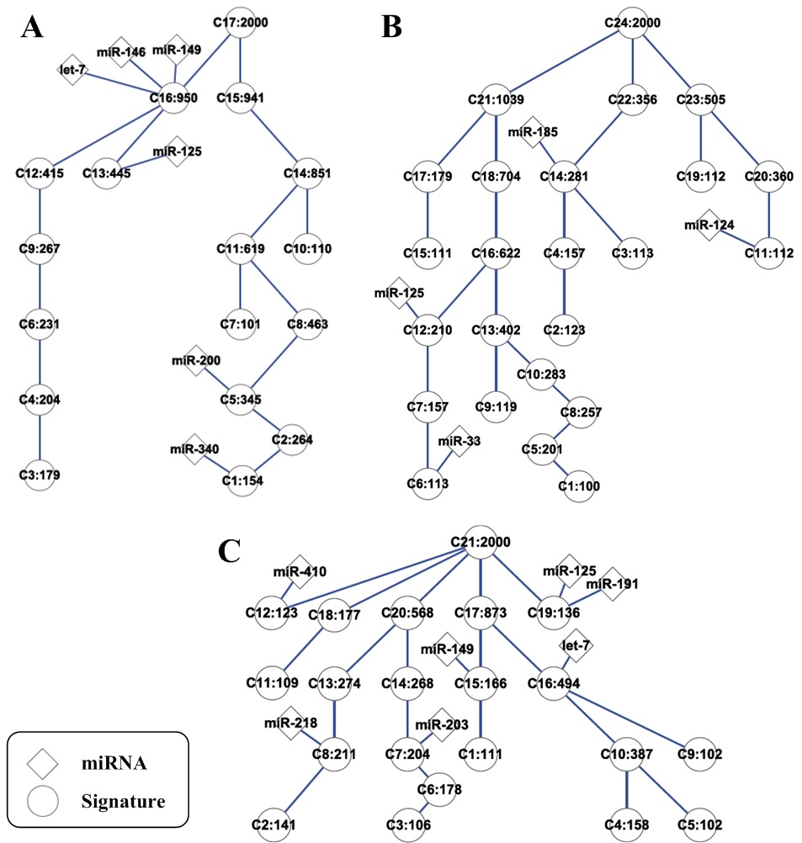
Figure 3. The perturbed miRNA regulatory networks in multiple cancer inferred by miRHiC. A) is for lung cancer; B) for hepatocellular cancer; and C) for colorectal cancer.

Slide 32
A few common onco-miRs across multiple cancers
The onco-miRs inferred in multiple cancers may play more important roles in cancer initiation and development.
Three miRNAs, miR-125, let-7 and miR-149 were inferred by miRHiC in two or more types of cancer.
MiR-149 (miR-149-5p) is a mammal conserved miRNA, its genetic polymorphisms are associated with the risk of cancer .
According to miRHiC inference, 53 non-redundant genes are targeted by miR-149: eight of them are shared by two types of cancer and CCT3 is shared by all the three studied types of cancer (Figure 4).
Based on its targets, it can be predicted that miR-149 may work as a cancer suppressor by targeting this chaperone protein.

Slide 33
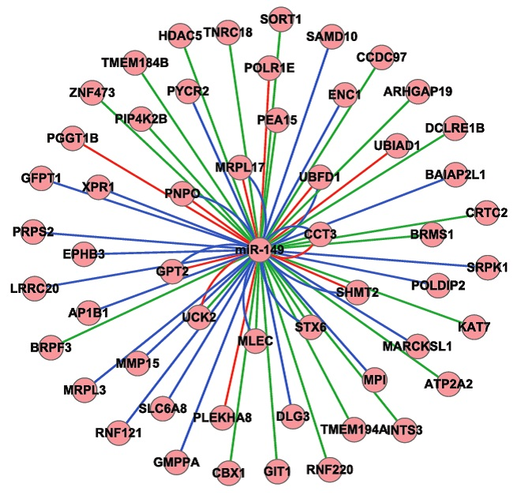
Figure 4. The perturbed miRNA-149 regulatory network in multiple cancers. The blue lines denote the network in LUC, green for HCC and red for CRC.

Slide 34
Discussion

Slide 35
Discussion
In this study, we developed miRHiC to infer the perturbed miRNA regulatory networks in cancer by incorporating the hierarchical gene co-expression information into miRNA target gene set enrichment analysis.
Results showed that miRHiC have much higher sensitivity for the inferences than the commonly used methods, such as HG-test, GSEA (based on FC only) and miRDeG (FAME), of which all do not use the hierarchical gene co-expression information (what happens if you run FAME on the results of hierarchical clustering ? Would miRHiC still provide some advantage?)

Slide 36
Resemblance to FAME…
“…like FAME, miRHiC used the bi-partite graph based permutation method, which can largely reduce this bias “ (3’-UTR bias)
“Besides the gene co-expression, the functional and regulatory interactions between genes (such as protein-protein interactions, transcriptional regulations and literature co-occurrences) can further be integrated to establish the hierarchical gene signatures”

Slide 37
Review Conclusions

Slide 38
Review Conclusions
Suggested method is largely an assembly of commonly used techniques.
The idea of partitioning the diff. genes before testing for enrichment is correct, but is this the main benefit of this approach ?
Comparison to other methods may be unfair.
Paper’s innovation mainly found in how they break the dendrogram yielded by classic hierarchical clustering into clusters. Why is this better than giving max cluster number as parameter to the normal hierarchical clustering algorithm ?
Not written very well…
Certain resemblance to FAME…

Slide 39
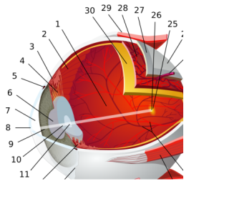
Integrated mRNA and miRNA expression analysis
RPE
Looking for miRNAs involved in eye development

Slide 40
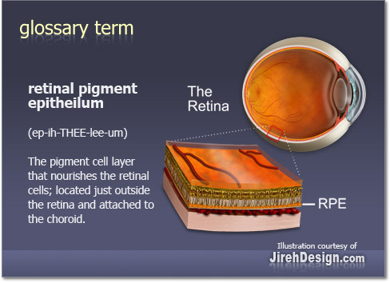
RPE
Retinal pigment epithelium
The retinal pigment epithelium (RPE) is the pigmented cell layer just outside the neurosensory retina that nourishes retinal visual cells, and is firmly attached to the underlying choroid and overlying retinal visual cells

Slide 41
Research Question
What is the function of miRNAs in RPE development?
What are the mRNA targets of these miRNAs?
Experimental data:
  Mouse: WT vs. Dicer Mutant
  Human: Differentiation - 5 days vs. 14 days

Slide 42
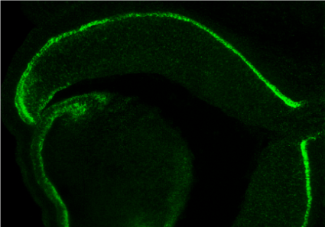
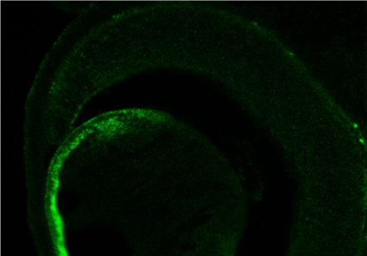
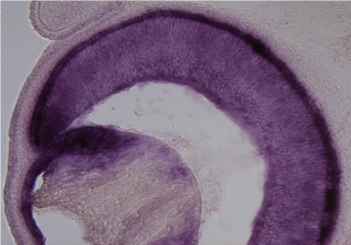
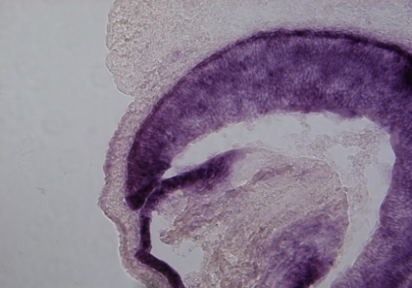
בס"ד
Ablation of Dicer1 in the RPE resulted in complete absence of mature miR-204
Dicer1^{f/f}
Dicer1^{f/f};DctCre
A
miR-204
B
Lens
Lens
E14.5
E
Trpm3
F
Lens
Lens
E10
E14.5
Dct-CRE
microRNA down regulation
42
Notes:
42
Fig 8. Ablation of Dicer1 in the RPE resulted in completely absence of mature miR-204/211
42

Slide 43
Research Question -> Work Plan
Translate the research question to computational analysis:
  Identify differentially expressed mRNAs
  Identify differentially expressed miRNAs
  Find a link between them
    Sequence based (Fame, TargetScan)
    Expression based (Correlation, by name)
  Return miRNA-mRNA pairs that supply all criteria mentioned above.

Slide 44
Gene Expression Analysis
Mouse RPE
3 WT vs. 3 Mutated Dicer
mRNA
Affy MoGene 1.0 Microarrays
34,760 probes
miRNA
Affy miRNA 2.0 Microarrays
20,248 probes
Multiple Organisms
Several miR types

Slide 45
Gene Expression Analysis
Mouse RPE
3 WT vs. 3 Mutated Dicer
mRNA
Affy MoGene 1.0 Microarrays
34,760 probes
miRNA
Affy miRNA 2.0 Microarrays
20,248 probes
Multiple Organisms
Several miR types

Slide 46
Gene Expression Analysis
Mouse RPE
3 WT vs. 3 Mutated Dicer
mRNA
Affy MoGene 1.0 Microarrays
34,760 probes
miRNA
Affy miRNA 2.0 Microarrays
20,248 probes

Slide 47
Gene Expression Analysis
Mouse RPE
3 WT vs. 3 Mutated Dicer
mRNA
Affy MoGene 1.0 Microarrays
34,760 probes
miRNA
Affy miRNA 2.0 Microarrays
20,248 probes

Slide 48
miRNA microarray
Class B Mean
Class B Mean
-
Class A Mean
Class A Mean

Slide 49
Gene Expression Analysis
Preprocessing
3 WT vs. 3 Mutated Dicer
mRNA
Affy MoGene 1.0 Microarrays
34,760 probes
CELL Files -> RMA
Expander (BioConductor)
Expression Console
Flooring
Variance Filter
T-test + FDR
Selected genes that exceeded given FDR and Fold-change cutoffs
miRNA
Affy miRNA 2.0 Microarrays
20,248 probes

Slide 50
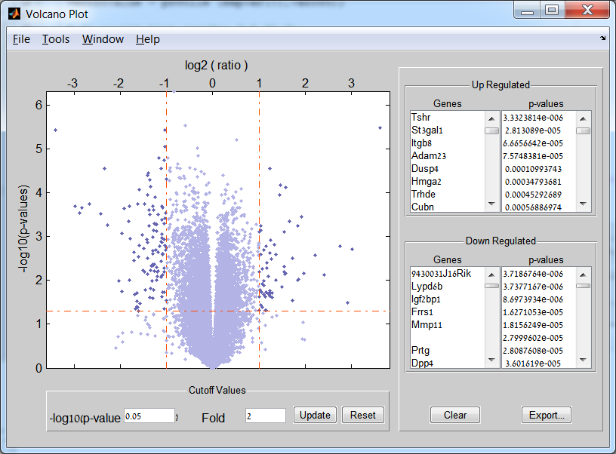

Slide 51
Differentially expressed mRNAs and miRNAs

Slide 52
Differentially expressed mRNAs and miRNAs
Upregulated miRNAs and downregulated mRNAs only

Slide 53
Differentially expressed mRNAs and miRNAs
Downregulated miRNAs and Upregulated mRNAs only

Slide 54
TargetScan Data
Latest TargetScan DB file was downloaded and processed into a miRNA-2-mRNA map.
Issues and comments:
  Chose PCT over Context Score
  miRNAs are grouped by families
  Score for each miRNA-mRNA interaction was calculated as max site score.
  Filtered out miRNA-mRNA pairs with maxPCT<0.5

Slide 55
Putting it all together…
Find downregulated mRNAs that are linked through TargetScan to upregulated miRNAs…

Slide 56
Parameters:
mRNA: FC>1.5 FDR<0.15
miRNA: FC>1.2 FDR<0.2
PCT> 0.5

Slide 58
Parameters:
mRNA: FC>1.5 FDR<0.2
miRNA: FC>1.1 FDR<0.3
PCT> 0.5

Slide 59
The End

